Slide 1
Selection Sort

Slide 2
Bubble Sort
Explanation of Bubble Sort
Visualization of Bubble Sort
Implementation of Bubble Sort

Slide 3
Bubble Sort
The bubble sort makes multiple passes through a list.
It compares adjacent items and exchanges those that are out of order.
Each pass through the list places the next largest value in its proper place.
Each item “bubbles” up to the location where it belongs.

Slide 4
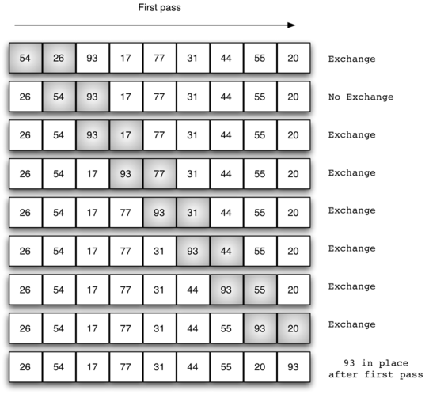
First pass of a Bubble Sort

Slide 5
Visualizations
Let’s take a look at some visualizations!

